Slide 1
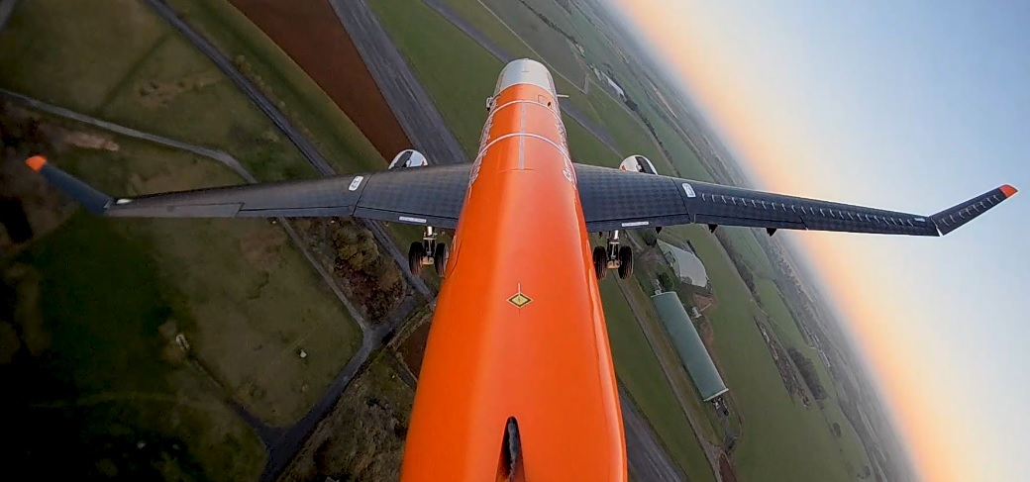

Flutter sensibility to semi-aeroelastic
hinged wing parameters
Tutor : Joseph Morlier
Carlos Nicolás Juarez Projet Innovation-Recherche
FORMATION INGÉNIEUR ISAE-SUPAERO
Notes:
Well, first of all good morning, today i’m going to present the progres in my investigation wich is a multidisciplinary design optimization of a semi-aeroelastic hinged wing with flutter constraint

Slide 2
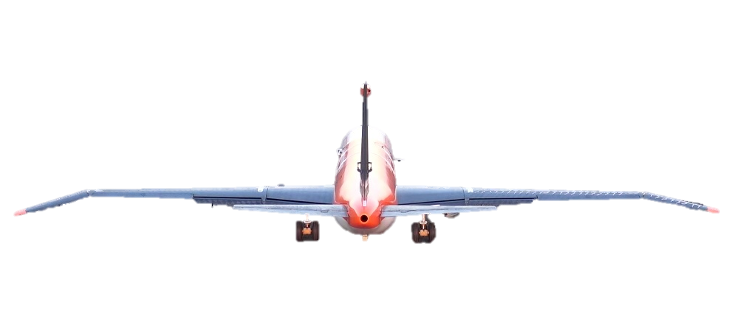
INTRODUCTION
/ Motivation
Increasing Wingspan
Lift induced drag reduction
Problems
Solution: Hinged Wing
maximum aircraft dimensions allowed at airports
increase in bending moments along the wing
Can be folded while grounded
Load alleviation at the root of the wing
Notes:
A brief review of the objective of the investigation. Much effort has been made to design aircraft to optimize fuel consumption through the reduction of aerodynamic drag. An important contribution to the overall drag is lift induced drag, which could be reduced by increasing the wingspan.
The problem is that such a design solution has well-defined limits imposed by the maximum aircraft dimensions allowed at airports, as well as the increase in bending moments along the wing.
A possible solution, that is analyzed here is the introduction of a hinge in order to allow the wingtips to rotate. This hinge could solve both problems, since it would allow the wingtip to be folded on ground in order to respect the reglamentation and with a correct design it can also produce load reduction on the aircraft during the flight.

Slide 3
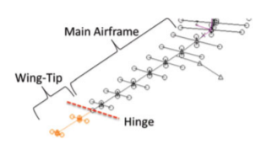
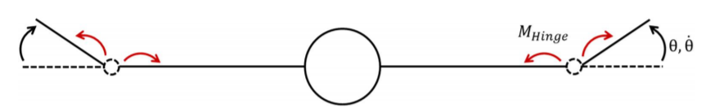
INTRODUCTION
/ Challenges
Aerodynamic and structural modeling
Design parameters influence
Hinge stiffness
Hinge position
Notes:
So there are 2 main challenges here, on one hand, the aerodynamic and structural modeling of the hinge and on the other hand, the flutter speed computation, since, at this moment, this is not something we can do in OpenAeroStruct

Slide 4
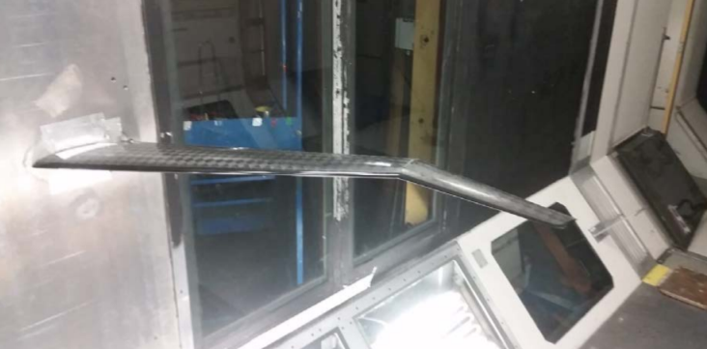
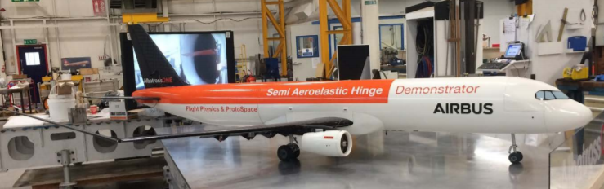
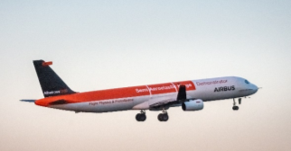
INTRODUCTION
/ Previous works
Small scale flying demonstration of semi aeroelastic hinged wing tips
Wilson, T., Kirk, J., Hobday, J., & Castrichini, A. (2019).
Notes:
This one is the AlbatrosONE project himself. Here we can see an empiric approach, the scale model is based on an airbus A321, with a 1:14 scale. In this paper the design of the plane geometry and control systems is described and the results of the flight are also given.

Slide 5
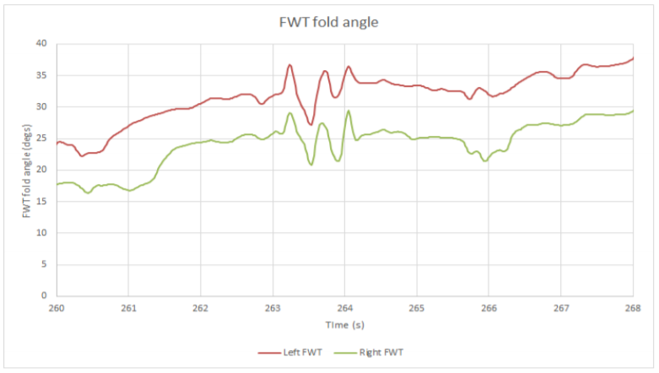
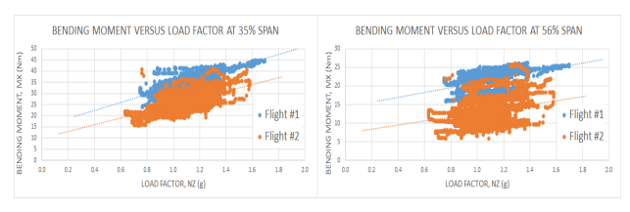
INTRODUCTION
/ Previous works
Small scale flying demonstration of semi aeroelastic hinged wing tips
Wilson, T., Kirk, J., Hobday, J., & Castrichini, A. (2019).
Notes:
This one is the AlbatrosONE project himself. Here we can see an empiric approach, the scale model is based on an airbus A321, with a 1:14 scale. In this paper the design of the plane geometry and control systems is described and the results of the flight are also given.

Slide 6
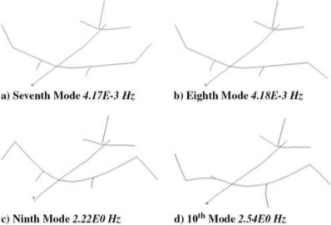
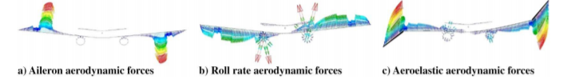
METHODS
/ Hinged wing previous works
Aeroelastics Flight Dynamics Coupling Effects of the Semi-Aeroelastic Hinge Device
Castrichini, A., Wilson, T., Saltari, F., Mastroddi, F., Viceconti, N., & Cooper, J. E. (2020).
Journal of Aircraft, 57(2), 333-341.
Notes:
This last one is a time domain analysis in order to study hinge effects on flight dynamics, so it is not that related to our flutter problem, but however i think it was interesting to see for example the structural modes as we can see in the image.

Slide 7
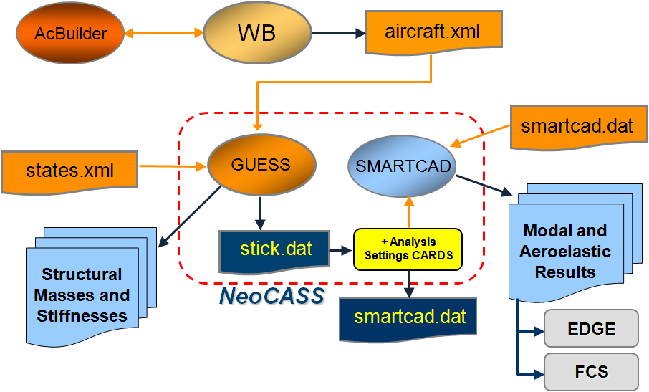
NeoCASS / Next generation Conceptual Aero‐Structural Sizing Suite
It Is a collection of Matlab ® analysis modules for:
Initial aircraft structural sizing
Modal analysis
Linear/non‐linear static analysis
Aeroelastic analysis (static aeroelasticity, flutter)
‘Flexible’ Aerodynamic stability derivatives.
Interfaced to:
External codes (Edge‐FOI, MSC/NASTRAN, others)
Notes:
Well now i’d like to talk about previous works on design optimization that uses flutter speed as a constraint. I have tried to focus on low-fidelity analyses.
This one for example, “Aeroelastic optimization design for High-Aspect-Ratio Wings with Large deformation”. Here i found the aerodynamic modeling analysis interesting as it uses VLM for steady loads computations and DLM for unsteady loads computation.
A comparison is done, between linear and nonlinear structural models when we work with large deformations.
It solves a gradient free optimization, which is not our case since openMDAO does gradient based optimizations.

Slide 8
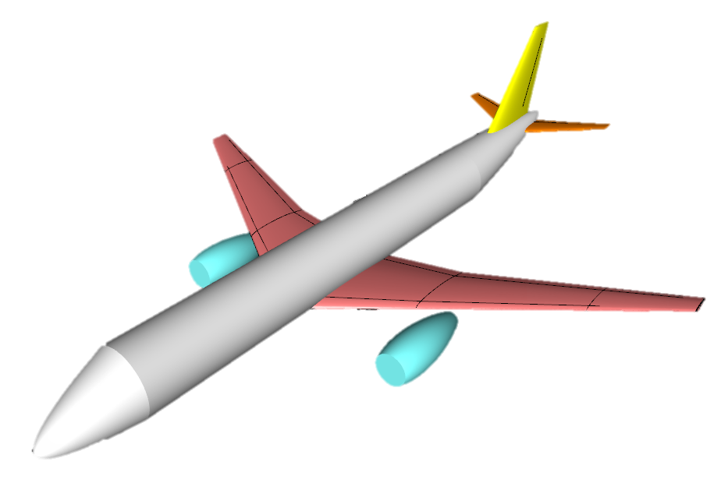
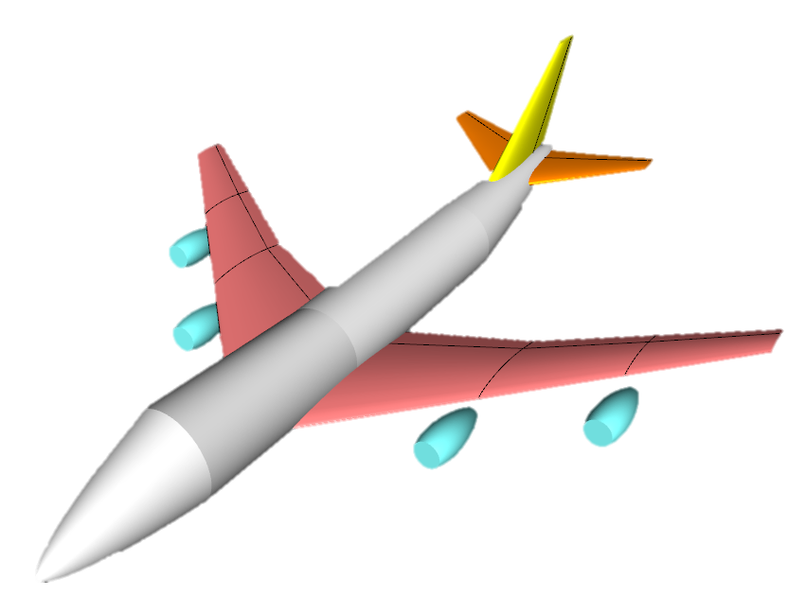
AIRCRAFT MODELLING
Low fidelity model
3 models used:
Short range + 10% wingspan
Short range + 25% wingspan
Long range
Long range model Geometric specifications
Overall length | 68.5 m
Wingspan | 59.64 m
Wing surface | 551 m²
MAC | 10.0695 m
Airfoil | N64A410
HTP Surface | 135 m²
VTP Surface | 77.11 m²
Notes:
Well now i’d like to talk about previous works on design optimization that uses flutter speed as a constraint. I have tried to focus on low-fidelity analyses.
This one for example, “Aeroelastic optimization design for High-Aspect-Ratio Wings with Large deformation”. Here i found the aerodynamic modeling analysis interesting as it uses VLM for steady loads computations and DLM for unsteady loads computation.
A comparison is done, between linear and nonlinear structural models when we work with large deformations.
It solves a gradient free optimization, which is not our case since openMDAO does gradient based optimizations.

Slide 9
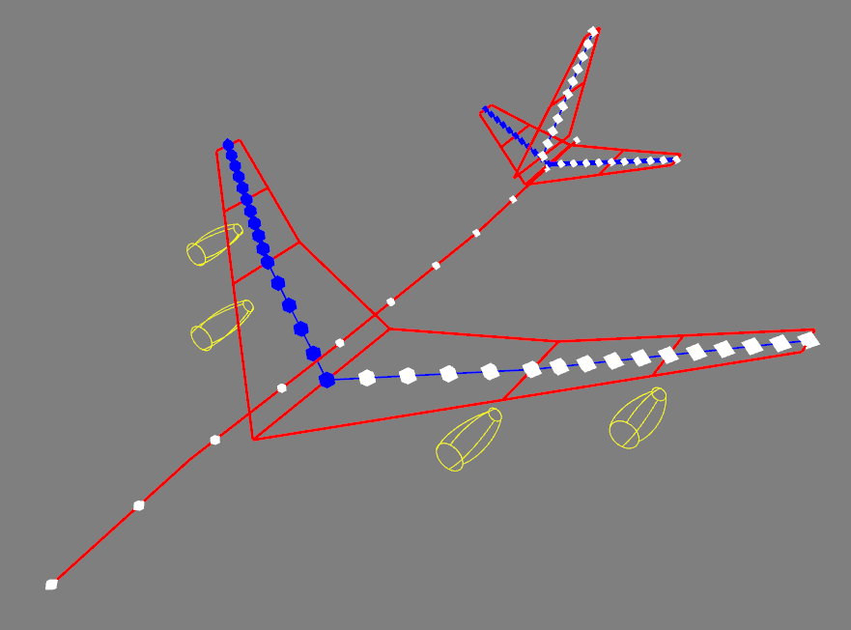
STRUCTURAL MODELLING
Linear beam elements
15 elements per semi wing
Notes:
Well now i’d like to talk about previous works on design optimization that uses flutter speed as a constraint. I have tried to focus on low-fidelity analyses.
This one for example, “Aeroelastic optimization design for High-Aspect-Ratio Wings with Large deformation”. Here i found the aerodynamic modeling analysis interesting as it uses VLM for steady loads computations and DLM for unsteady loads computation.
A comparison is done, between linear and nonlinear structural models when we work with large deformations.
It solves a gradient free optimization, which is not our case since openMDAO does gradient based optimizations.

Slide 10
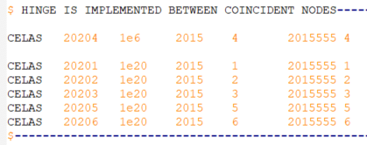
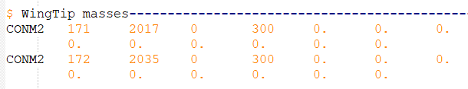
STRUCTURAL MODELLING
Hinge implementation between nodes “2015” and “2016”
CELAS
Nastran scalar element used to model springs
Hinge stiffness is given to the rotation around “x” axis
CONM2
Allows the specification of a concentrated mass
Mass addition to the wingtip
Wingtip mass is needed to evidence hinge stiffness influence
Notes:
Well now i’d like to talk about previous works on design optimization that uses flutter speed as a constraint. I have tried to focus on low-fidelity analyses.
This one for example, “Aeroelastic optimization design for High-Aspect-Ratio Wings with Large deformation”. Here i found the aerodynamic modeling analysis interesting as it uses VLM for steady loads computations and DLM for unsteady loads computation.
A comparison is done, between linear and nonlinear structural models when we work with large deformations.
It solves a gradient free optimization, which is not our case since openMDAO does gradient based optimizations.

Slide 11
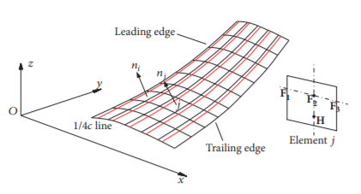
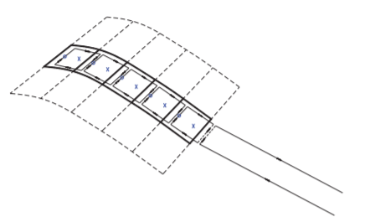
AERODYNAMIC MODELLING
Doublet lattice method (DLM)
To compute unsteady aerodynamic loads
Based on aerodynamic potential theory
Lifting pressures concentrated across the one-quarter chord line of each panel
One control point per panel on the three-quarter chord line
Notes:
Well now i’d like to talk about previous works on design optimization that uses flutter speed as a constraint. I have tried to focus on low-fidelity analyses.
This one for example, “Aeroelastic optimization design for High-Aspect-Ratio Wings with Large deformation”. Here i found the aerodynamic modeling analysis interesting as it uses VLM for steady loads computations and DLM for unsteady loads computation.
A comparison is done, between linear and nonlinear structural models when we work with large deformations.
It solves a gradient free optimization, which is not our case since openMDAO does gradient based optimizations.

Slide 12
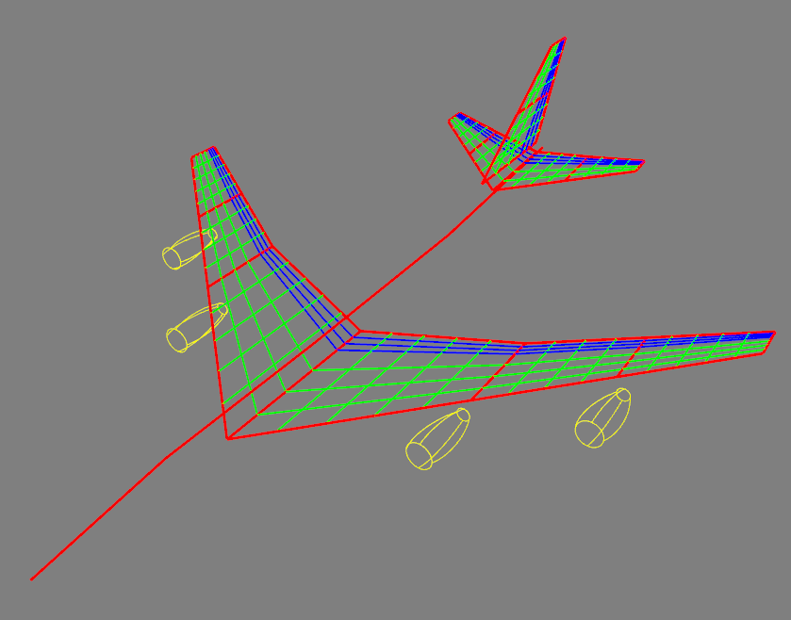
AERODYNAMIC MODELLING
14 span-wise divisions
7 chord-wise divisions
Notes:
Well now i’d like to talk about previous works on design optimization that uses flutter speed as a constraint. I have tried to focus on low-fidelity analyses.
This one for example, “Aeroelastic optimization design for High-Aspect-Ratio Wings with Large deformation”. Here i found the aerodynamic modeling analysis interesting as it uses VLM for steady loads computations and DLM for unsteady loads computation.
A comparison is done, between linear and nonlinear structural models when we work with large deformations.
It solves a gradient free optimization, which is not our case since openMDAO does gradient based optimizations.

Slide 13
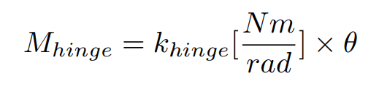
ANALYZED PARAMETERS
/ Hinge stiffness
Hinge stiffness
Chosen stiffness values [Nm/rad]
1e3 | 1e4 | 5e4 | 1e5 | 5e5 | 1e6 | 5e6 | 1e7 | 5e7 | 1e8 | Hingeless
Notes:
Well now i’d like to talk about previous works on design optimization that uses flutter speed as a constraint. I have tried to focus on low-fidelity analyses.
This one for example, “Aeroelastic optimization design for High-Aspect-Ratio Wings with Large deformation”. Here i found the aerodynamic modeling analysis interesting as it uses VLM for steady loads computations and DLM for unsteady loads computation.
A comparison is done, between linear and nonlinear structural models when we work with large deformations.
It solves a gradient free optimization, which is not our case since openMDAO does gradient based optimizations.

Slide 14
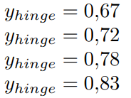
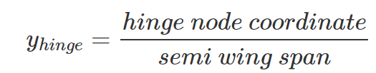
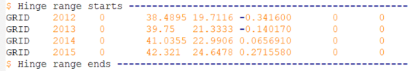
ANALYZED PARAMETERS
/ Hinge position
Hinge position
Notes:
ver cuanto es la extensión de la envergadura en el AlbatrossONE

Slide 15
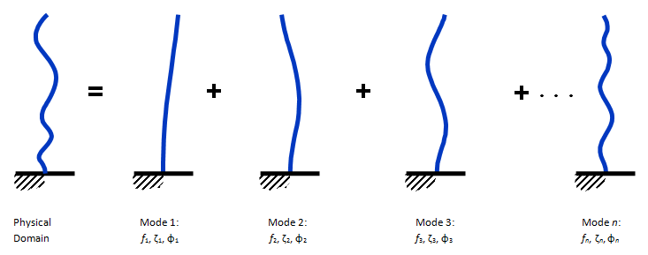
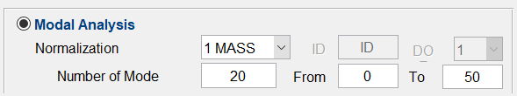
MODAL ANALYSIS
In order to compute flutter, modal analysis is needed first
The purpose of a modal analysis is to find the shapes and frequencies at which the structure will amplify the effect of a load.
Notes:
Well now i’d like to talk about previous works on design optimization that uses flutter speed as a constraint. I have tried to focus on low-fidelity analyses.
This one for example, “Aeroelastic optimization design for High-Aspect-Ratio Wings with Large deformation”. Here i found the aerodynamic modeling analysis interesting as it uses VLM for steady loads computations and DLM for unsteady loads computation.
A comparison is done, between linear and nonlinear structural models when we work with large deformations.
It solves a gradient free optimization, which is not our case since openMDAO does gradient based optimizations.

Slide 16
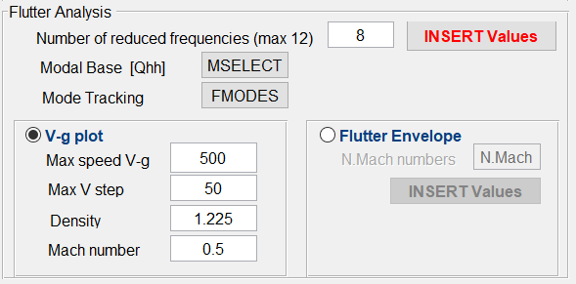
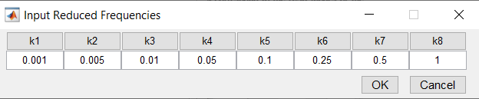
FLUTTER ANALYSIS
M = 0.5
ρ = 1.225 [kg/m³]
Modal base: all 20 computed modes
Flutter tracking: modes 7 and 8
Notes:
Well now i’d like to talk about previous works on design optimization that uses flutter speed as a constraint. I have tried to focus on low-fidelity analyses.
This one for example, “Aeroelastic optimization design for High-Aspect-Ratio Wings with Large deformation”. Here i found the aerodynamic modeling analysis interesting as it uses VLM for steady loads computations and DLM for unsteady loads computation.
A comparison is done, between linear and nonlinear structural models when we work with large deformations.
It solves a gradient free optimization, which is not our case since openMDAO does gradient based optimizations.

Slide 17
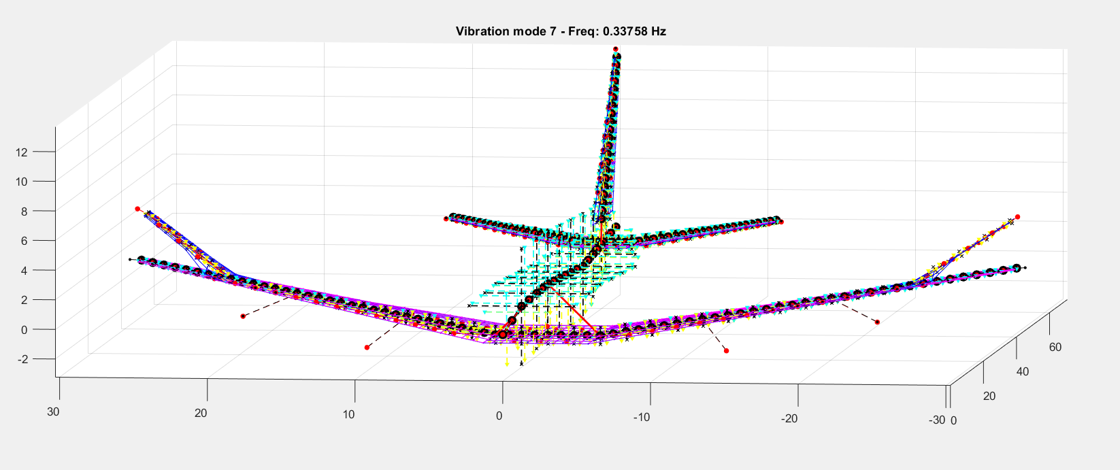
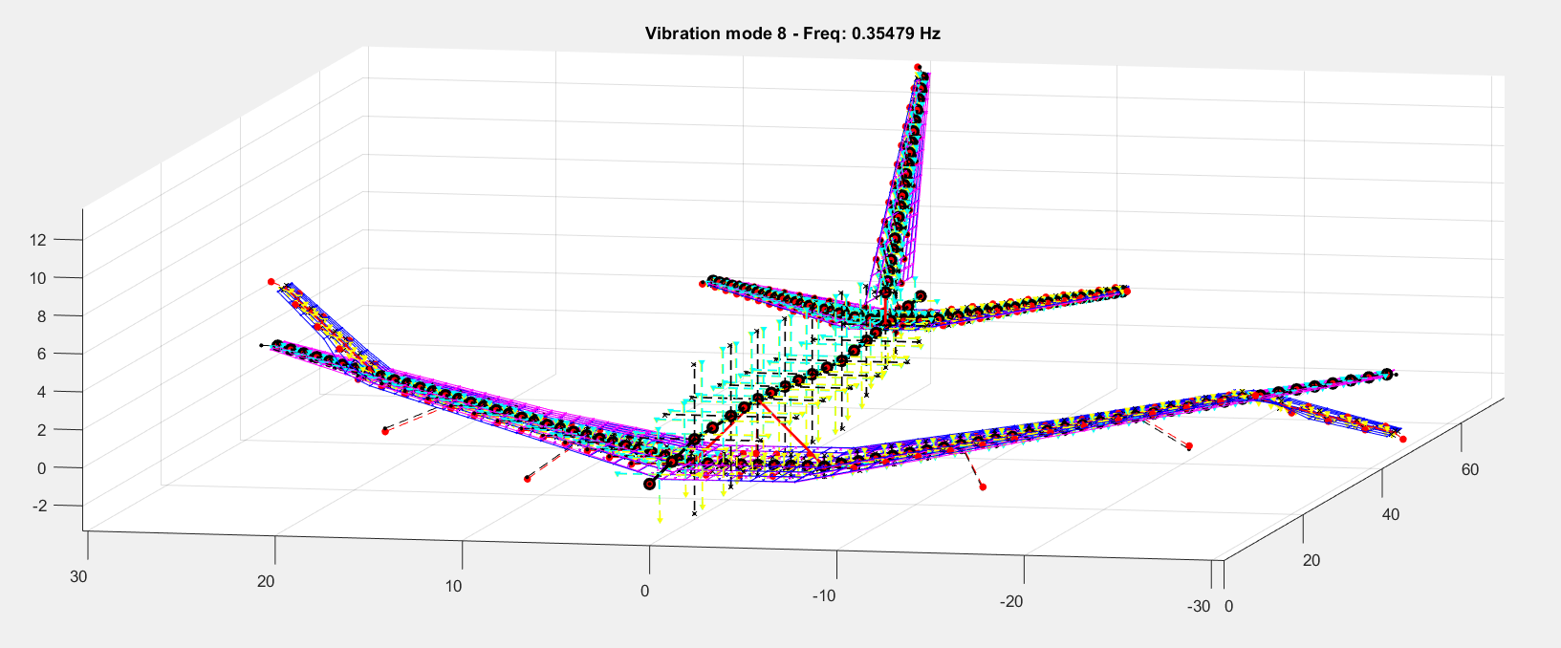
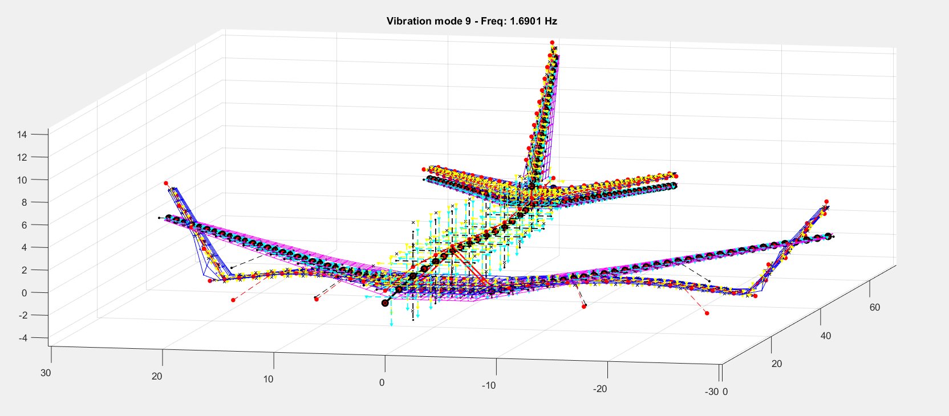
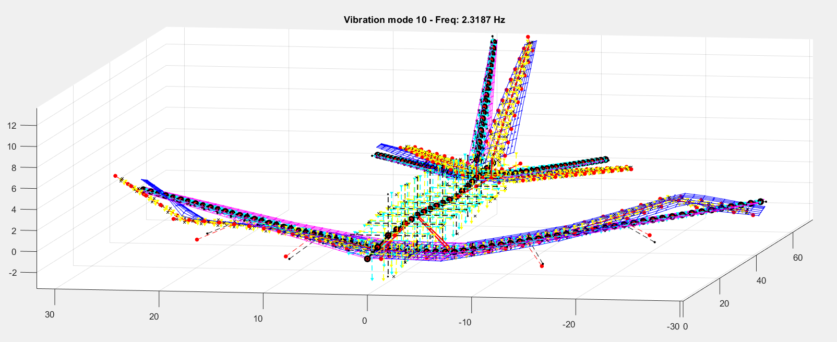
RESULTS
/ Modes
First modes for K_{hinge}=1e5 [Nm/rad] y_{hinge}=0.78
Non- rigid modes
N° | Freq. [Hz]
7 | 0.3376
8 | 0.3548
9 | 1.6901
10 | 2.3187
11 | 3.439
12 | 3.5041
13 | 3.9006
14 | 4.1129
15 | 5.0978
16 | 5.205
17 | 6.4436
18 | 6.4626
19 | 7.59
20 | 7.978
Notes:
Well now i’d like to talk about previous works on design optimization that uses flutter speed as a constraint. I have tried to focus on low-fidelity analyses.
This one for example, “Aeroelastic optimization design for High-Aspect-Ratio Wings with Large deformation”. Here i found the aerodynamic modeling analysis interesting as it uses VLM for steady loads computations and DLM for unsteady loads computation.
A comparison is done, between linear and nonlinear structural models when we work with large deformations.
It solves a gradient free optimization, which is not our case since openMDAO does gradient based optimizations.

Slide 18
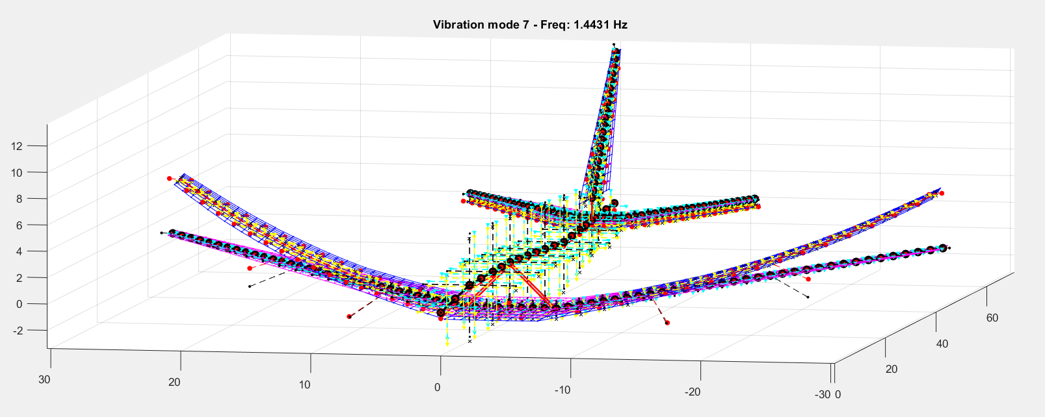
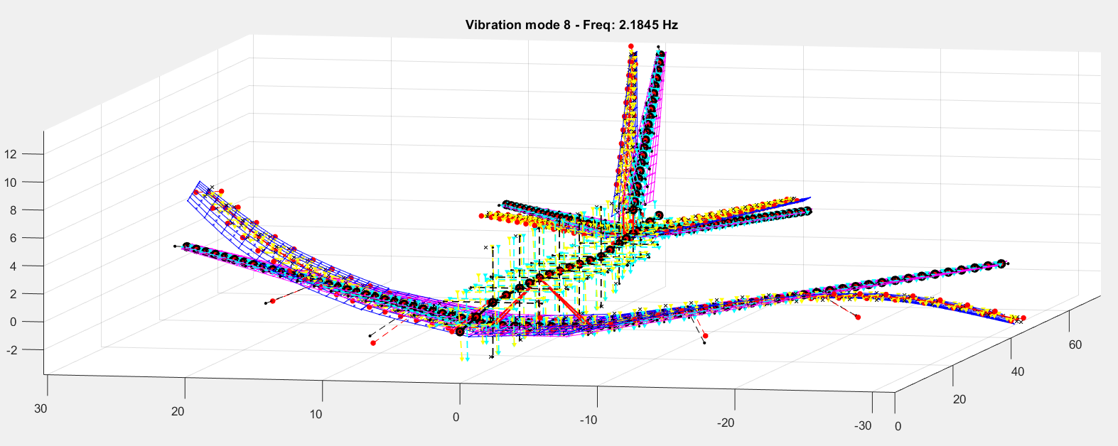
RESULTS
/ Modes
k_{hinge} = 1e5 [Nm/rad]
Wingtip modes
Increasing hinge stiffness
k_{hinge} = 1e8 [Nm/rad]
Wing modes
Notes:
Well now i’d like to talk about previous works on design optimization that uses flutter speed as a constraint. I have tried to focus on low-fidelity analyses.
This one for example, “Aeroelastic optimization design for High-Aspect-Ratio Wings with Large deformation”. Here i found the aerodynamic modeling analysis interesting as it uses VLM for steady loads computations and DLM for unsteady loads computation.
A comparison is done, between linear and nonlinear structural models when we work with large deformations.
It solves a gradient free optimization, which is not our case since openMDAO does gradient based optimizations.

Slide 19
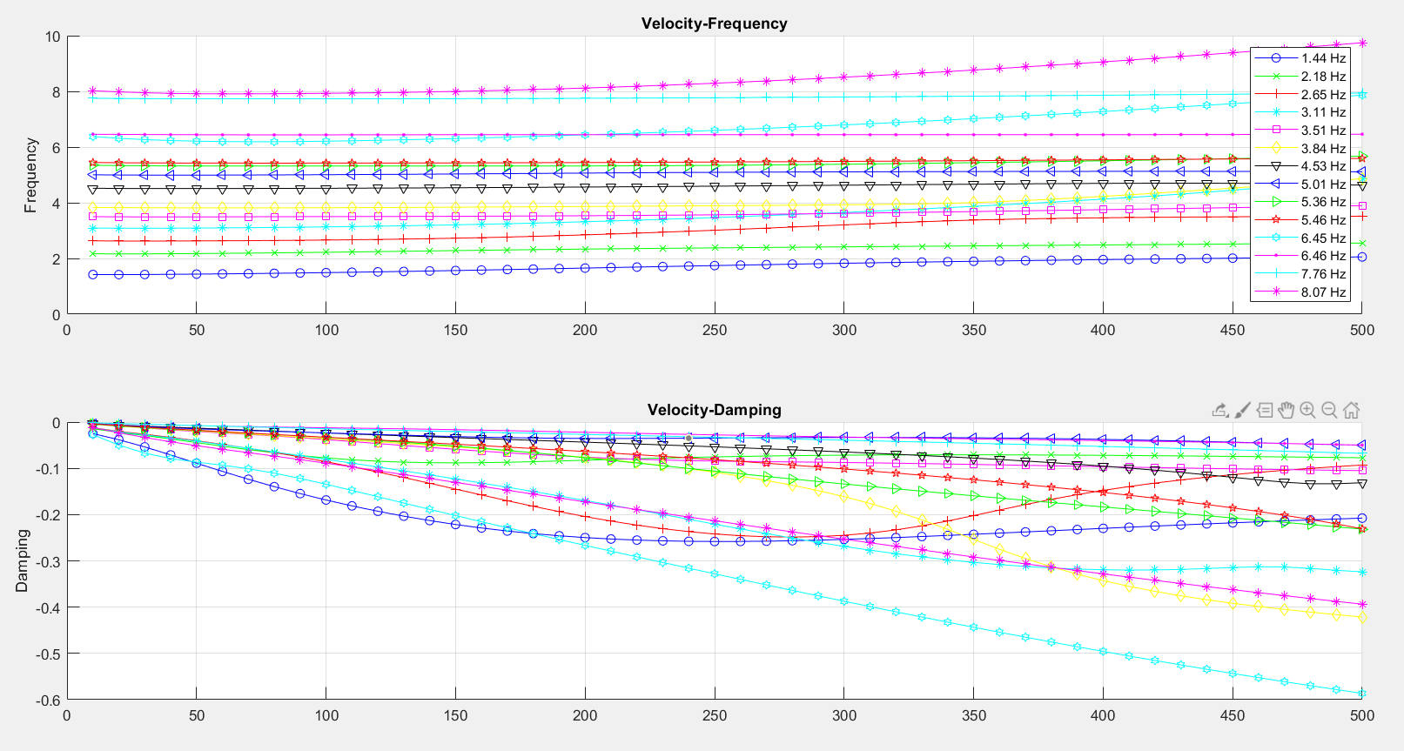
RESULTS
/ Flutter
Notes:
Well now i’d like to talk about previous works on design optimization that uses flutter speed as a constraint. I have tried to focus on low-fidelity analyses.
This one for example, “Aeroelastic optimization design for High-Aspect-Ratio Wings with Large deformation”. Here i found the aerodynamic modeling analysis interesting as it uses VLM for steady loads computations and DLM for unsteady loads computation.
A comparison is done, between linear and nonlinear structural models when we work with large deformations.
It solves a gradient free optimization, which is not our case since openMDAO does gradient based optimizations.

Slide 20
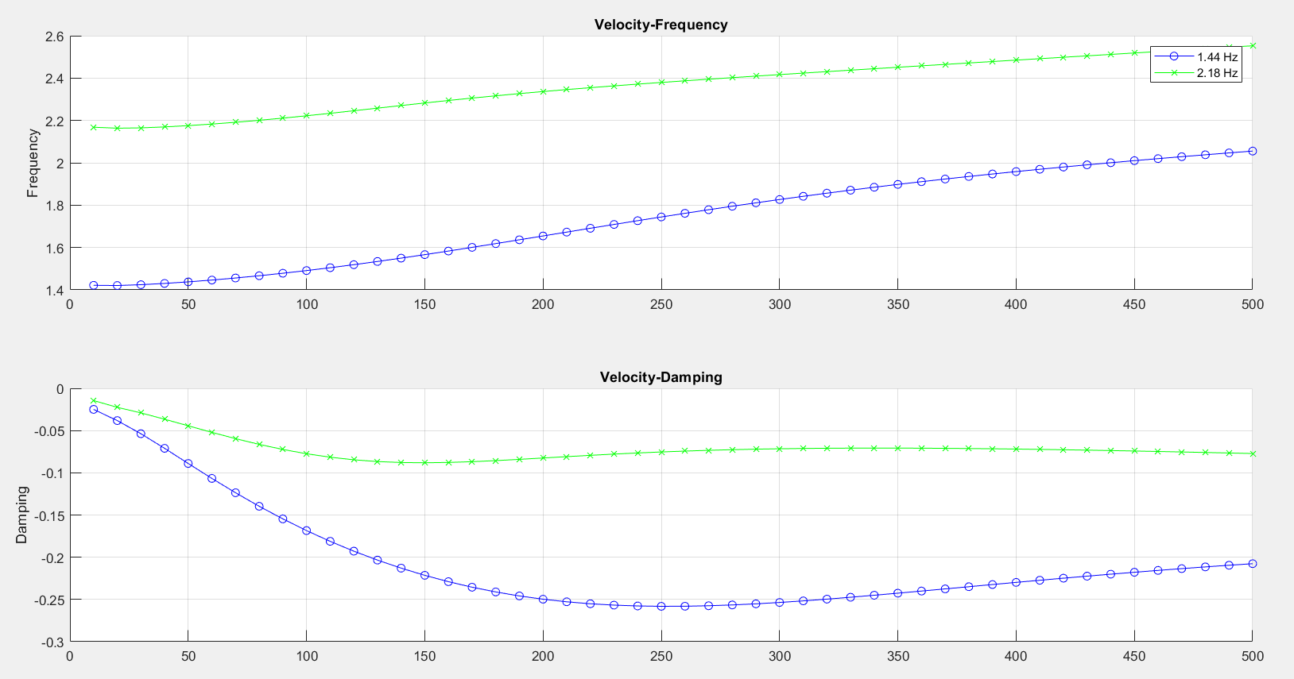
RESULTS
/ Flutter
Notes:
Well now i’d like to talk about previous works on design optimization that uses flutter speed as a constraint. I have tried to focus on low-fidelity analyses.
This one for example, “Aeroelastic optimization design for High-Aspect-Ratio Wings with Large deformation”. Here i found the aerodynamic modeling analysis interesting as it uses VLM for steady loads computations and DLM for unsteady loads computation.
A comparison is done, between linear and nonlinear structural models when we work with large deformations.
It solves a gradient free optimization, which is not our case since openMDAO does gradient based optimizations.

Slide 21
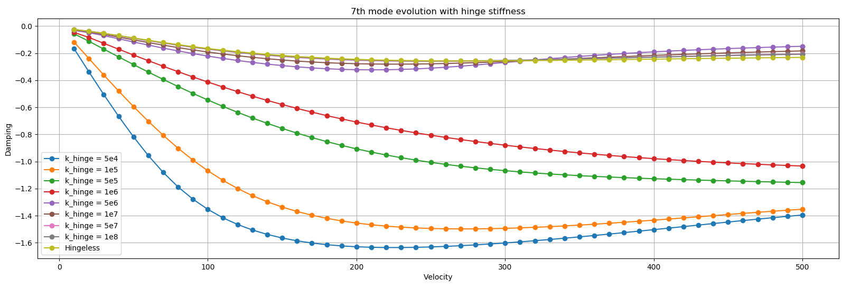
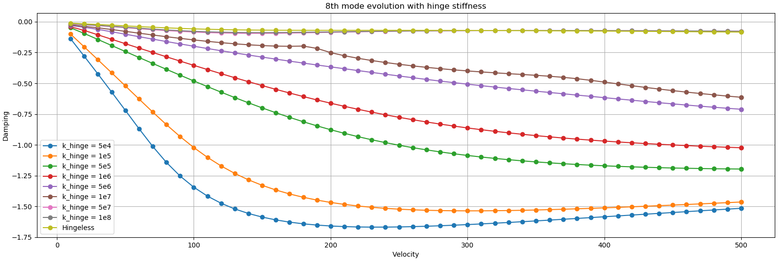
RESULTS
/ Hinge stiffness influence
Increasing stiffness
7th Mode
Increasing stiffness
8th Mode
Notes:
Well now i’d like to talk about previous works on design optimization that uses flutter speed as a constraint. I have tried to focus on low-fidelity analyses.
This one for example, “Aeroelastic optimization design for High-Aspect-Ratio Wings with Large deformation”. Here i found the aerodynamic modeling analysis interesting as it uses VLM for steady loads computations and DLM for unsteady loads computation.
A comparison is done, between linear and nonlinear structural models when we work with large deformations.
It solves a gradient free optimization, which is not our case since openMDAO does gradient based optimizations.

Slide 22
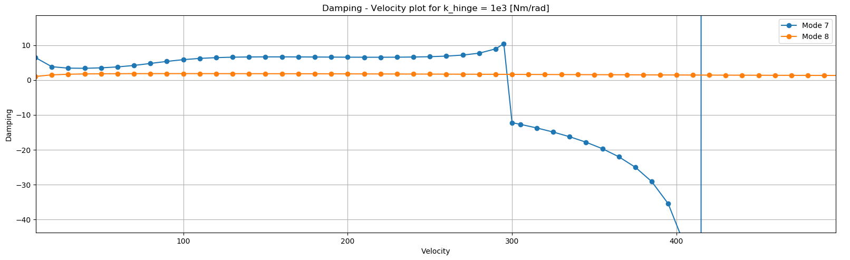
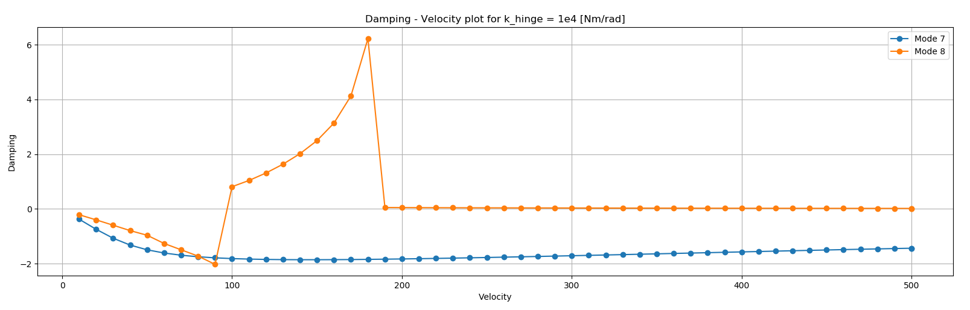
RESULTS
/ Hinge stiffness influence
K_{hinge}=1e3
K_{hinge}=1e4
Notes:
Well now i’d like to talk about previous works on design optimization that uses flutter speed as a constraint. I have tried to focus on low-fidelity analyses.
This one for example, “Aeroelastic optimization design for High-Aspect-Ratio Wings with Large deformation”. Here i found the aerodynamic modeling analysis interesting as it uses VLM for steady loads computations and DLM for unsteady loads computation.
A comparison is done, between linear and nonlinear structural models when we work with large deformations.
It solves a gradient free optimization, which is not our case since openMDAO does gradient based optimizations.

Slide 23
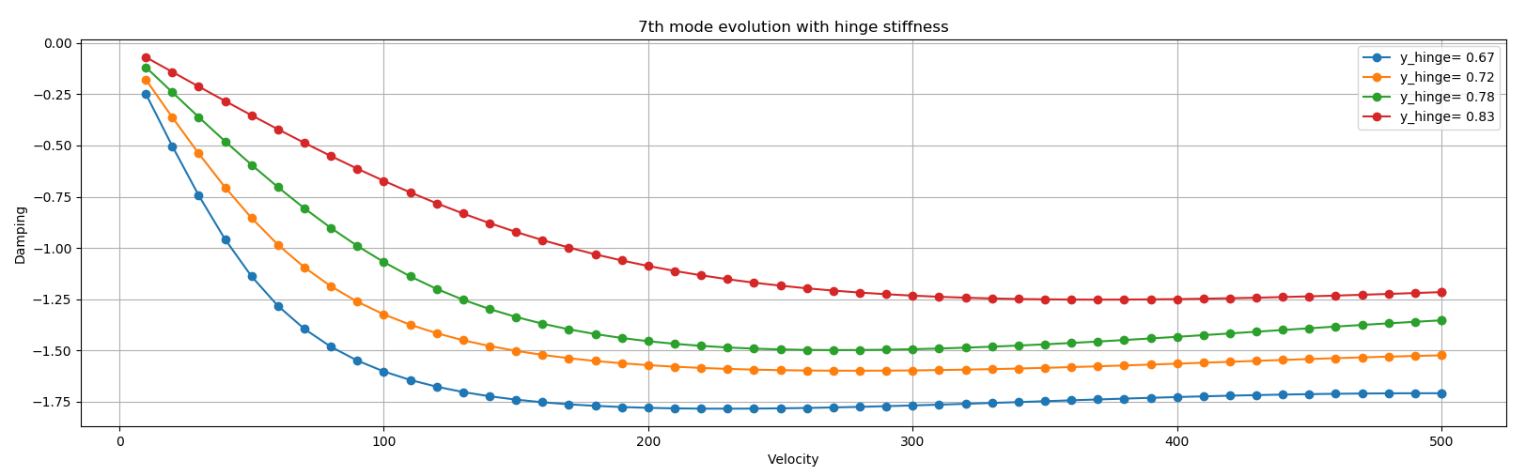
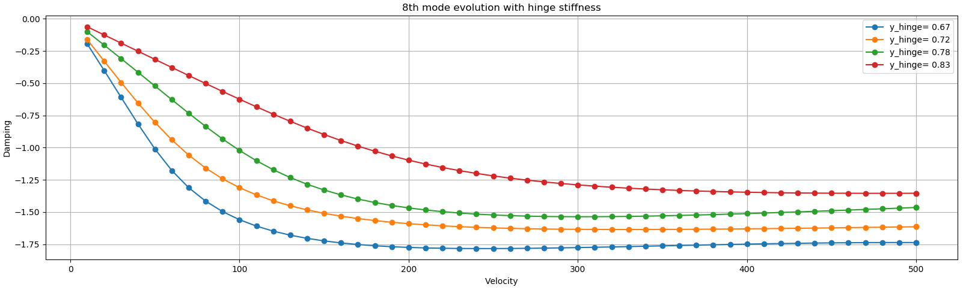
RESULTS
/ Hinge position influence
Outward
displacement
7th Mode
Outward displacement
8th Mode
Notes:
Well now i’d like to talk about previous works on design optimization that uses flutter speed as a constraint. I have tried to focus on low-fidelity analyses.
This one for example, “Aeroelastic optimization design for High-Aspect-Ratio Wings with Large deformation”. Here i found the aerodynamic modeling analysis interesting as it uses VLM for steady loads computations and DLM for unsteady loads computation.
A comparison is done, between linear and nonlinear structural models when we work with large deformations.
It solves a gradient free optimization, which is not our case since openMDAO does gradient based optimizations.

Slide 24
CONCLUSIONS
A certain stiffness is needed in order to avoid flutter
If the hinge stiffness is increased the mode damping decreases
From khinge=5e6 [Nm/rad] the modes behave like the hingeless case
Moving the hinge inboard increases the damping of the modes
Notes:
Well now i’d like to talk about previous works on design optimization that uses flutter speed as a constraint. I have tried to focus on low-fidelity analyses.
This one for example, “Aeroelastic optimization design for High-Aspect-Ratio Wings with Large deformation”. Here i found the aerodynamic modeling analysis interesting as it uses VLM for steady loads computations and DLM for unsteady loads computation.
A comparison is done, between linear and nonlinear structural models when we work with large deformations.
It solves a gradient free optimization, which is not our case since openMDAO does gradient based optimizations.

Slide 25
FUTURE WORKS
Flare angle modelling
High-fidelity models implementation
MDO application to find optimal design

Slide 26
REFERENCES
Cardani, Cesare, and Paolo Mantegazza. "Continuation and direct solution of the flutter equation." (1978): 185-192.
Cavagna, L., Ricci, S., & Travaglini, L. (2011). NeoCASS: an integrated tool for structural sizing, aeroelastic analysis and MDO at conceptual design level. Progress in Aerospace Sciences, 47(8), 621-635.
Castrichini, A., Siddaramaiah, V. H., Calderon, D. E., Cooper, J. E., Wilson, T., & Lemmens, Y. (2017). Preliminary investigation of use of flexible folding wing tips for static and dynamic load alleviation. The Aeronautical Journal, 121(1235), 73-94.
Saquet, P. (2011). Further developments of the AcBuilder tool for constructing geometrical models of aircraft.
Castrichini, A., Wilson, T., Saltari, F., Mastroddi, F., Viceconti, N., & Cooper, J. E. (2020). Aeroelastics Flight Dynamics Coupling Effects of the Semi-Aeroelastic Hinge Device. Journal of Aircraft, 57(2), 333-341.
Wilson, T., Azabal, A., Castrichini, A., Cooper, J., Ajaj, R., & Herring, M. (2016). Aeroelastic behaviour of hinged wing tips.
Cavagna, L., Ricci, S., & Travaglini, L. (2011). Aeroelastic analysis and optimization at conceptual design level using NeoCASS suite. In 52nd AIAA/ASME/ASCE/AHS/ASC Structures, Structural Dynamics and Materials Conference 19th AIAA/ASME/AHS Adaptive Structures Conference 13t (p. 2079).
Wilson, T., Kirk, J., Hobday, J., & Castrichini, A. (2019). SMALL SCALE FLYING DEMONSTRATION OF SEMI AEROELASTIC HINGED WING TIPS.

Slide 27
Thank you!

